Slide 1
Kedamawi Mulualem
User Guid

Slide 2
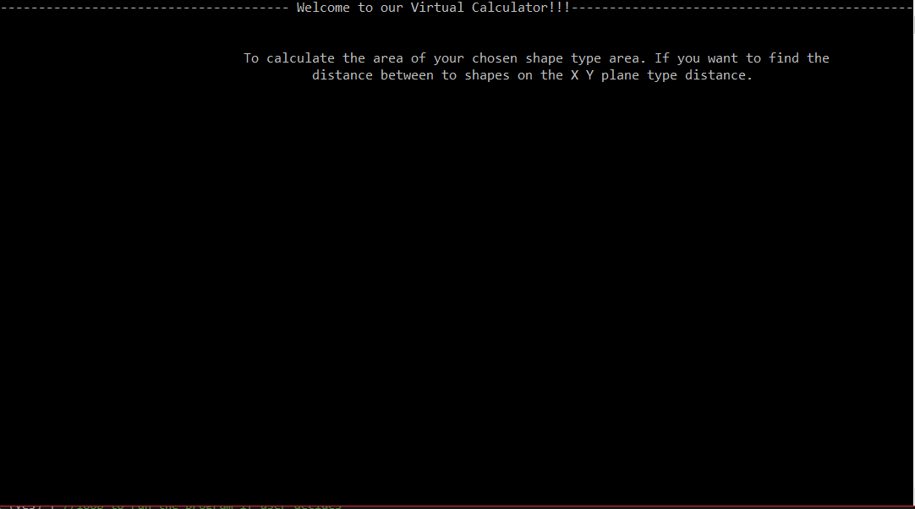
When you launch the program, type if you want to calculate the area of a given shape or the distance between the center of two given shapes.

Slide 3
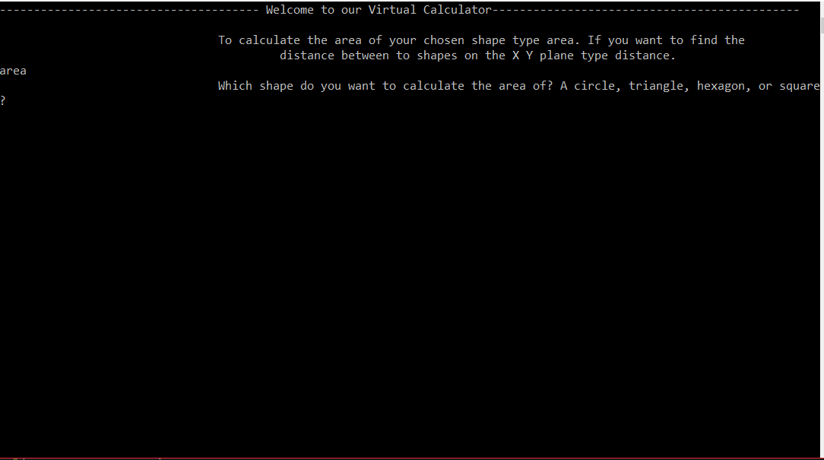
If you select area then it will prompt you to type the shape you would like to determine the area of.

Slide 4
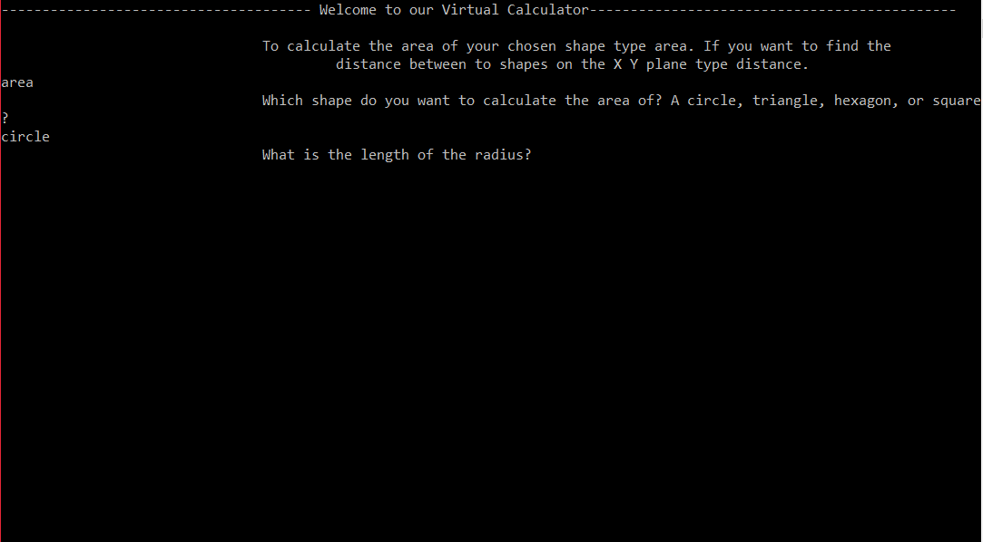
If you type for circle it will ask you for the radius. If you type square, triangle, or hexagon it will ask for the length of one side.

Slide 5
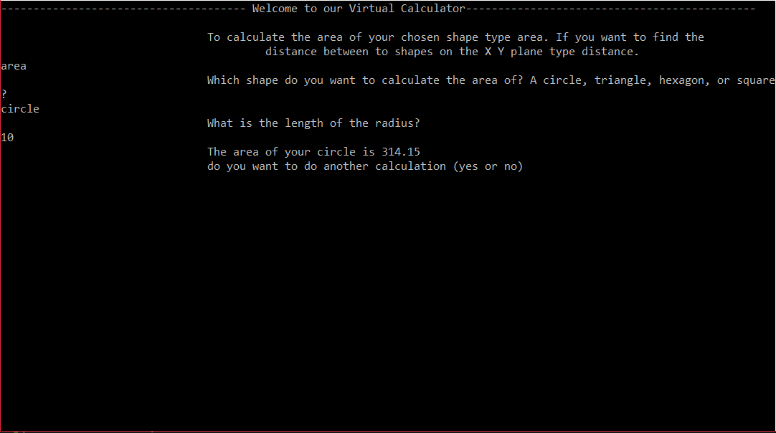
Once you enter the length of the radius or side it will calculate the area, it will ask if you would like to make another calculation.

Slide 6
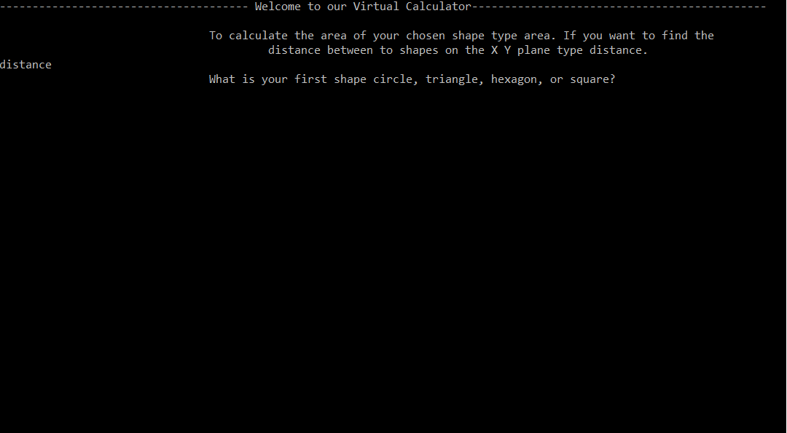
If you select the option to find the distance between the center of two shapes it will ask the for the first shape.

Slide 7
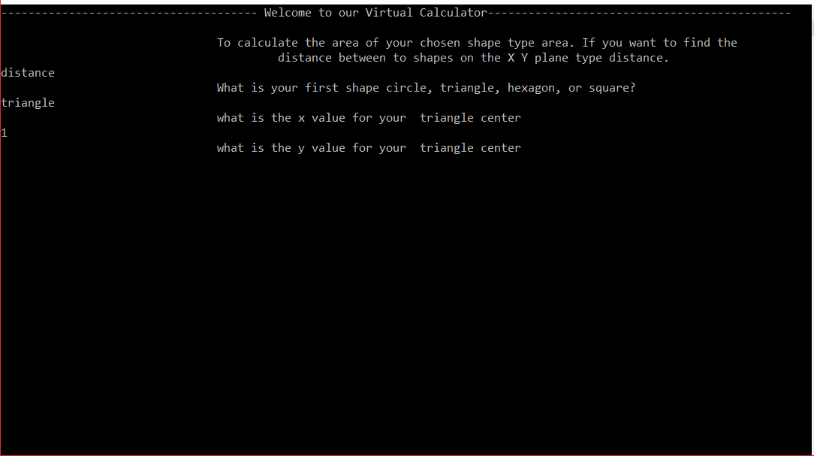
After you select the shape it will ask for the x and y values of the center point.

Slide 8
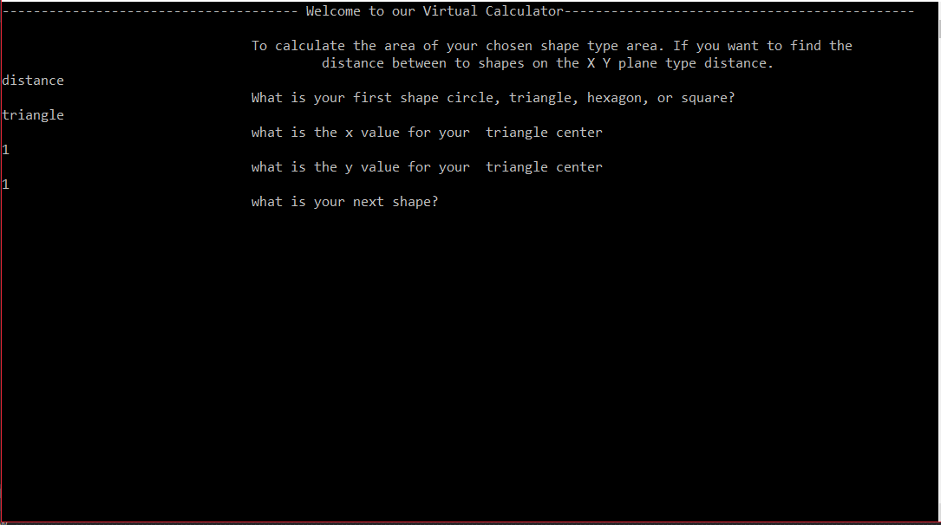
It will then ask for the name of the second shape.

Slide 9
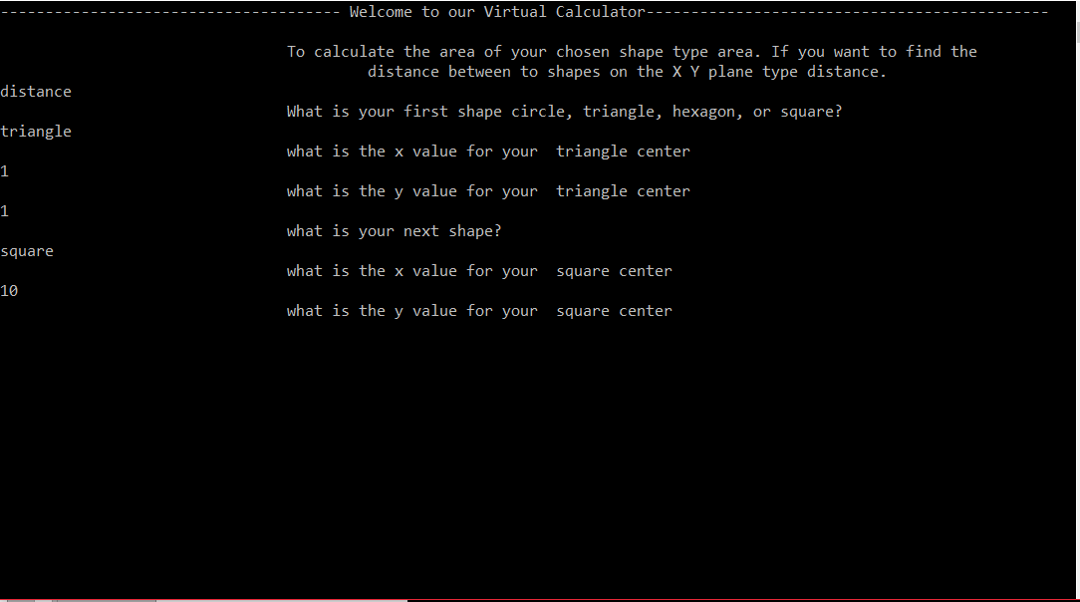
When the second shape is selected it will ask for the center x and y values.

Slide 10
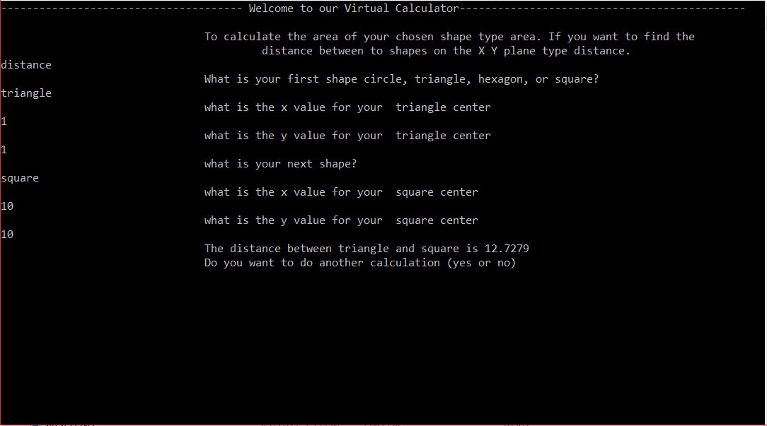
Once the second shapes center coordinates are entered it will calculate the distance then ask the user if they would like to run the program again.

